Slide 1
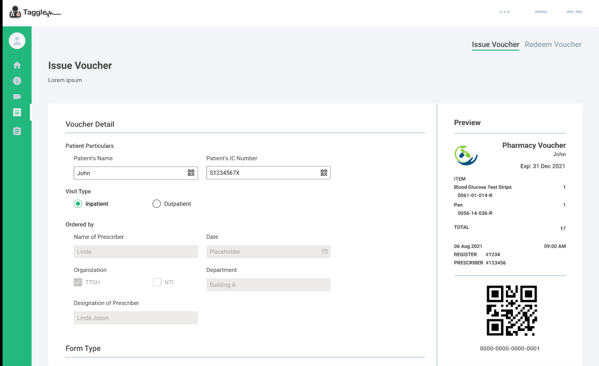
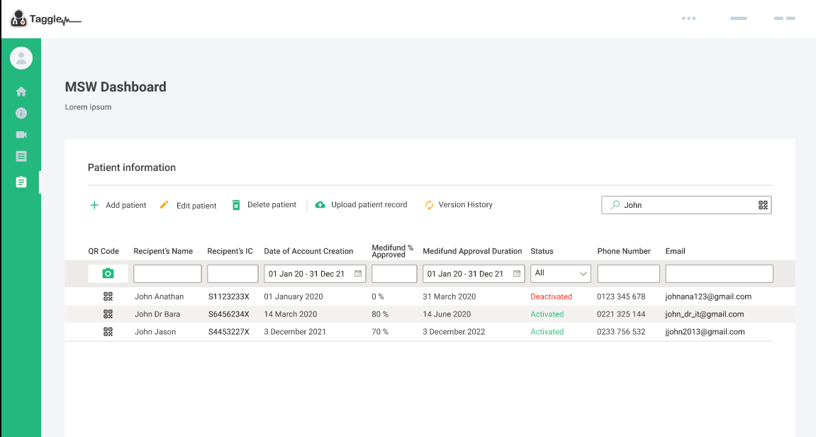
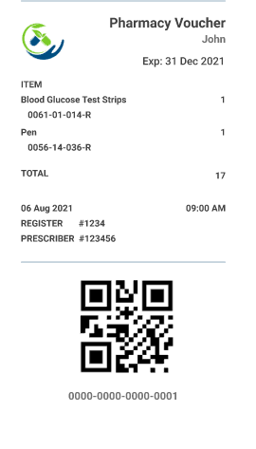
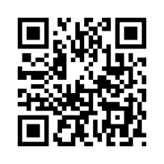
eCoupon
Taggle HealthApp
eWallet
Taggle Portal
REDEEMED eCoupon
REDEEM eCoupon
Pharmacy ID

Slide 2
Taggle API
Patient Account Login
Retrieve Patient Info
Retrieve/ Vouchers
Display Voucher
Edit Voucher Item Quantity for Purchases
Redeem Voucher
Taggle API
MSW/Clinician Account Login
Retrieve Patient Info
Assign Subsidy
Retrieve Voucher
Create Voucher
Issue Voucher
Edit/Delete Voucher
Create Packages
Taggle eWallet
eCoupon
Taggle Mobile App
Taggle Portal
Taggle WebApp
REDEEMED eCoupon
Pharmacy ID
REDEEM eCoupon

Slide 3
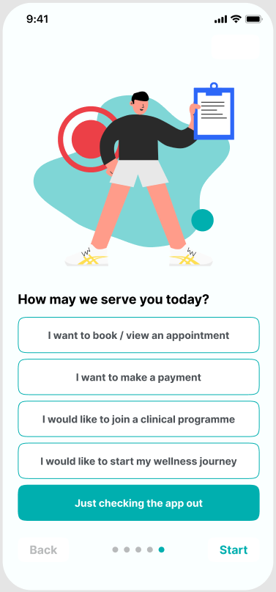
First Time User Experience (FTUE) - QnA
FTUE (last question)
For new users of HAP, part of the onboarding process is answering the FTUE QnA.
Last question in FTUE is “How may we serve you today?” This page will provide new users a shortcut for them to directly dive into the journeys they desired.
For Wellness journey, user’s entry point to the journey will be selecting:
I would like to start my wellness journey
Upon tap of Start, user will be directed to FTUE completion page.
FTUE Completion
After successfully completing the FTUE QnA, this page will be displayed to inform user that he/she already have completed the initial setup.
Upon tap of Continue, user will be directed to the journey selected on the previous page, “I would like to start my wellness journey”
To start the wellness journey, user will initially be invited to do a Singpass login in order to create a user profile for personalization of the journey contents and flow.
Notes:
"I would like to join a clinical programme", "I would like to start my wellness journey"
Slide 5 – Thinking from a User point of view…
“I want to join a programme” – Not sure whether the user will understand what this means. Maybe need to specify what do we mean by programme?“wellness programme?” “fitness programme?”
“I want to focus on my Learning” – just wondering whether the user will struggle to tell the difference between this option and the “I want to join a programme” option. Not sure if this needs further elaboration for the user to appreciate the difference between the options?

Slide 4
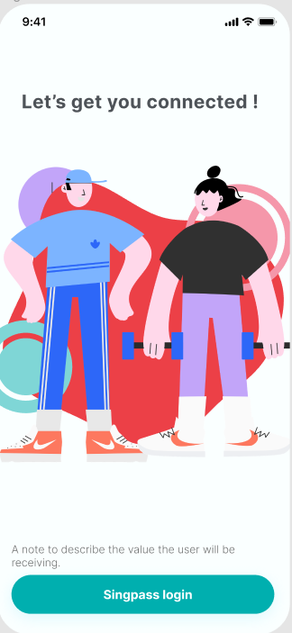
Singpass Login
Singpass Login
Once the user has successfully logged in, next page that will be displayed is the Experience Customization Survey.
Proceed without login
If the user chose to Proceed without login, he/she will be directed to My Learning page without any personalization.
My Learning page is for everyone. All general contents can be explored by the user but other functionalities which requires user profile like set goal, log mood, etc will not be available for users who is not logged in.
Proceed without login

Slide 5
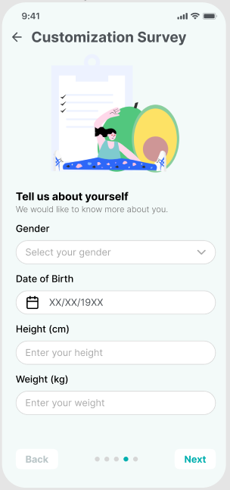
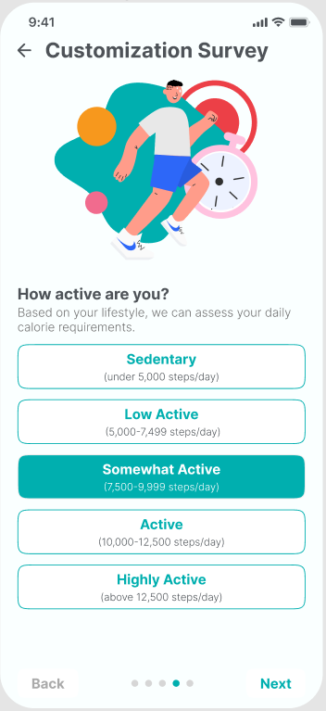
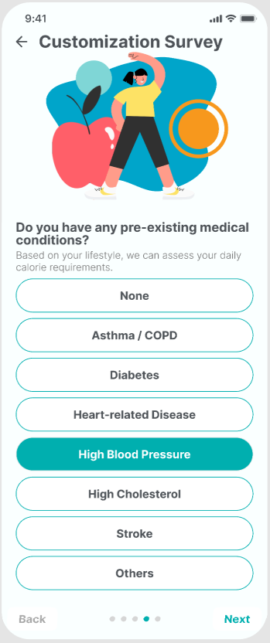
Experience Customization Survey
Initial set of survey questions to create a personalized user experience will be:
Gender, DOB, Height(cm), Weight(kg)
All fields are empty be default
How active are you?
1 selection only
Do you have any pre-existing medical conditions?
allow multiple selection
Note:
These survey questions can be customizable in backend.
Notes:
we can remove the occupation, then add the steps per day
Add another question: Do you have any pre-existing medical conditions?
None, Diabetes, Hypertension, High Cholesterol, Cardiovascular Disease, Asthma, Others
Dr David I’m wondering whether the “How active are you?” questionnaire should be tweaked for a few reasons:
The current flow does not change as a result of the questions so there might be some redundancy there.
There may be office workers who exercise daily, and the questions currently listed might make it difficult to answer for such patients.
Should we just ask about physical activity levels and / or exercise, and separately ask about occupation if this is something we want to capture?
Dr Edward Slide 7
I can see the potential to use this survey to gather more patient/user information in the future.
Agree that for the first launch, these few questions may be adequate for now.
Other questions, which may be useful to consider in the future include smoking, alcohol, and average hours of sleep a day maybe.

Slide 6
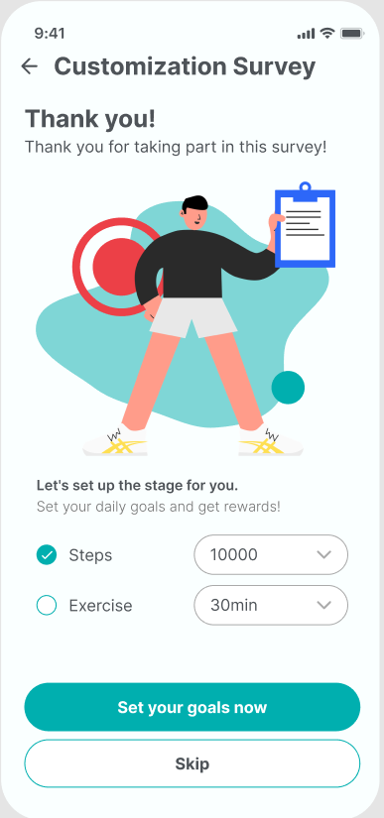
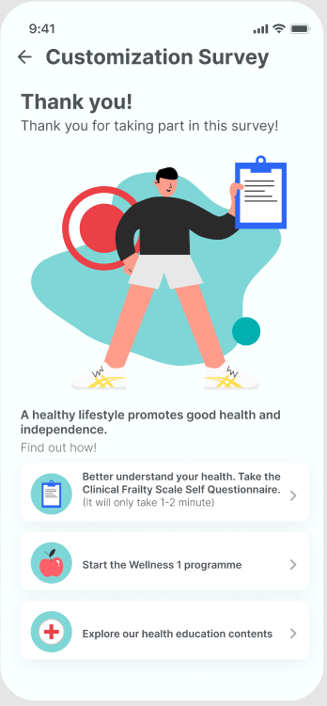
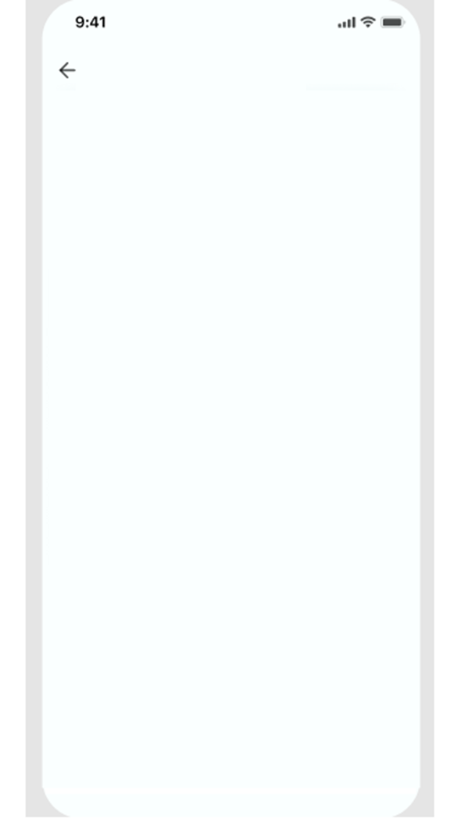
Experience Customization Survey (Algorithm)
Algorithm:
If age >= 60 or pre-existing condition <> None,
If No Clinical Frailty Score yet, invite user to take CFS self questionnaire. Upon selection, user will be directed to the questionnaire.
Invite user to start the <wellness programme> (this displays the Title of the lesson curated for robust users). Upon selection, user will be asked to do a health declaration before diving into the lessons page.
Ask user to explore the health education contents. Upon selection, user will be directed to My Learning main page.
If age < 60
Invite user to set default daily goals (Steps, Exercise).
Set your goals now - user will be asked to do a health declaration before saving the goals.
Skip - user will be directed to My Learning main page.
Let’s set up the stage for you
Default steps will be 10,000, user can select options 5000, 6000... 10,000 but user is allowed to input any number
Default exercise will be 30 mins, selection options will be 15, 30, 45, 60. but user is allowed to input any duration
Note: Age threshold set-up will be configurable in HAP backend.
Thank you for taking part of this survey!
You have earned 10 EXP!
Let’s set up the stage for you.
Set your daily goals and get rewards!
10,000 steps
30 mins exercise
Update UI
Notes:
“A healthy lifestyle now promotes independence and good health as we get older. Find out how”
“To better understand your general health status, please take the Clinical Frailty Scale questionnaire (it will only take you 1-2 minute.)”.
Need health advisory
Agree that if no chronic medical conditions, and less than 50 years old, we can set their goals for 10,000 Steps and 30min Exercise
Remove water intake and sleep goals.
allow user to change for Daily goals value
- steps default 10000, max 10000,
exercise default 30mins

Slide 7
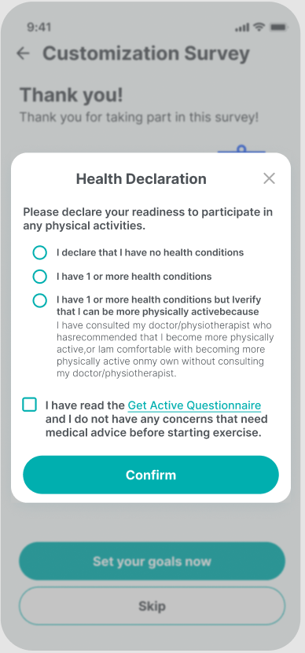
Health Declaration
Users will be asked to fill up the health declaration:
once they set up goals for the first time.
once they start any programme(lesson) for the first time
(as programme might include physical activities tasks)
In health declaration page, user declares their readiness to participate in any physical activities. User also needs to declare that they have read the Get Active Questionnaire. There will be a hyperlink for users to click and read the questionnaire from healthhub website. Get Active Questionnaire word will be underlined as it is a link to the questionnaire. User need so click that to enable the checkbox.
https://www.healthhub.sg/sites/assets/Assets/Article%20Images/Get%20Active%20Questionnaire.pdf
Confirm button is default disabled. Will be enabled once both 1 and 2 are answered.
Upon Confirm, user will be directed to their desired action.
Health Declaration will have an expiry date. Once expired, user will be asked to fill up the health declaration again. Expiry date will be set to 90 days.
NOTE:
If the user selects NONE on the pre-existing condition page(Slide 8), to default answer to 1st option. disable the other 2 options.
If the user selection is not NONE in the pre-existing condition page(Slide 8), to default answer to 3rd option., disable first option.
Notes:
Some other thoughts before patients access the exercise material:
Will we need to administer Get Active Questionnaire / PARQ, or share the material as part of general exercise advice similar to what Health Hub / HPB are doing?
Will we need to put in some disclaimers like we are not responsible for any mishaps, see a doctor for further advice in certain situations etc?

Slide 8
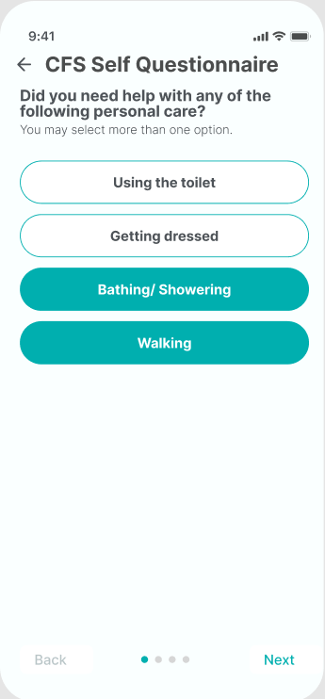
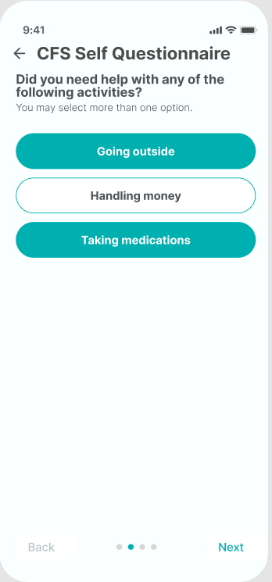
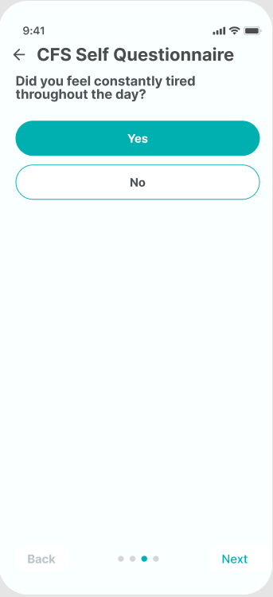
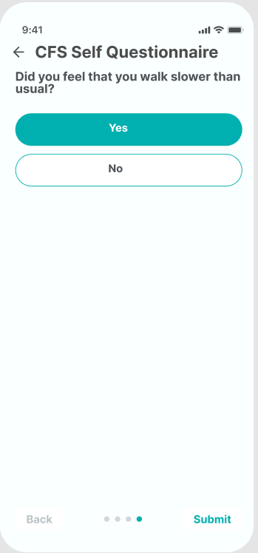
Clinical Frailty Scale Self Questionnaire
User will be able to select multiple answers to questions 1 & 2.

Slide 9
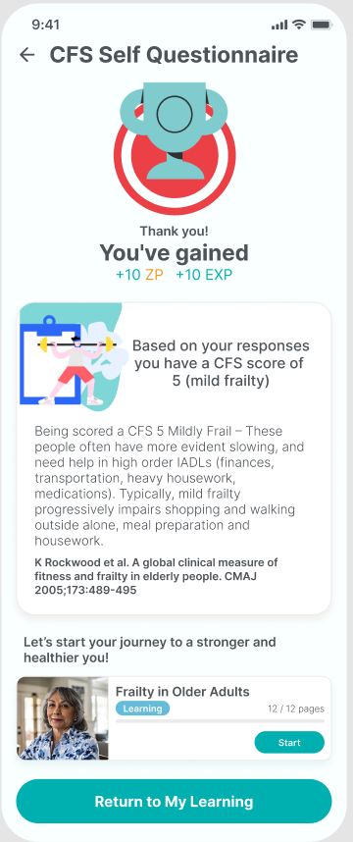
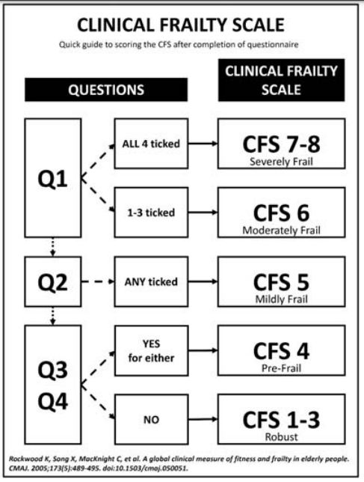
Clinical Frailty Scale Self Questionnaire
After completing the questionnaire, next step would be derived based on what score the user got.
There will be 3 different levels:
Level 1: CFS 1 -3
Level 2: CFS 4 or 5
Level 3: CFS 6 or more
Once user scored 4 and above – There will be a question displayed before the recommended programme.“Do you want our program manager to contact you? Yes/No”. If the user answered yes, there will be an indicator in provider portal that this user wants to be contacted.
NOTE: Lesson contents for 3 levels can be found at https://drive.google.com/drive/folders/1QfdVFmbEtQ9ekqX9AQFKxzNmU1CzbUvj?usp=sharing
Notes:
Dr Edward: “Thank you for taking part in this survey. Based on your responses, you have a CFS score of 5 (mild frailty). Being scored a CFS 5 means… (we could use the original descriptor from the CFS)” Then the user can click Next to acknowledge that they have read the descriptor, then the next page will be “Let’s start your journey to a stronger and healthier you!” then we can direct the user to the relevant programmes and PE materials based on their CFS score.
Dr David: The NHGP PEM on exercise for frailty is divided as follows:
We can splice the material so depending on the CFS score the patient can receive material suited to his / her needs.

Slide 10
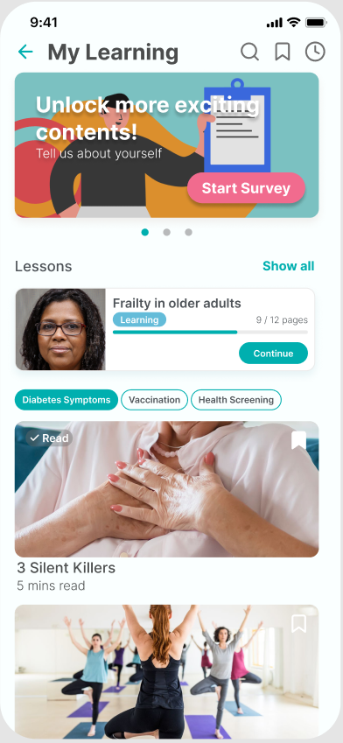
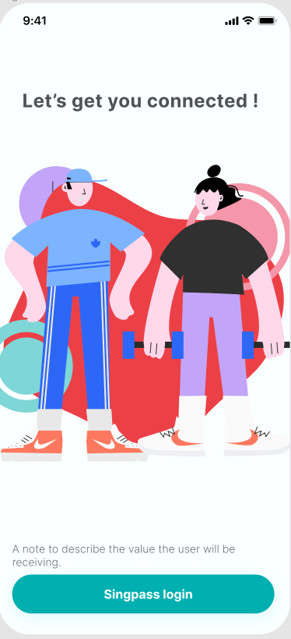
My Learning (main)
My Learning page will be the main page for wellness journey.
The page includes:
Featured carousel
My Lessons (Wellness programme)
Content Assets by Categories tab
Search bar
Featured carousel, wellness programmes and content assets will be personalized based on the user’s data accumulated eg. profile, health status, transactions. (FR8.1.3)
FEATURED CAROUSEL
Carousel will include:
image (to catch user’s attention)
title (to relay user the information)
button (to let user explore more about the information)
To display one featured content for each category (FR8.1.2)
If user is not logged in yet, 1 of the items in featured carousel will be the invitation for user to answer the survey.
If user age >= 60 and no CFS score yet, 1 of the items in featured carousel will be the invitation for user to answer the CFS Questionnaire.
Upon tap of the button (Read More), user will be directed to the specific content page.
MY LESSONS (Wellness Programmes)
To display 3 recommended programmes based on personalization algo.
Active programme will be displayed before the recommended ones.
Upon tap of Start or Continue, Programme details page will be displayed.
Tap See All to display the lessons list page.
If a non-login user tries to access features that needs login, a page will be displayed to invite user to login.
After successfully logging in, user will be directed to the desired feature/content.
Notes:
display in 2 rows programmes and content assets
add latest content on top.. sort by relevance (as per user data), latest
If finish reading.. Need to have marker

Slide 11
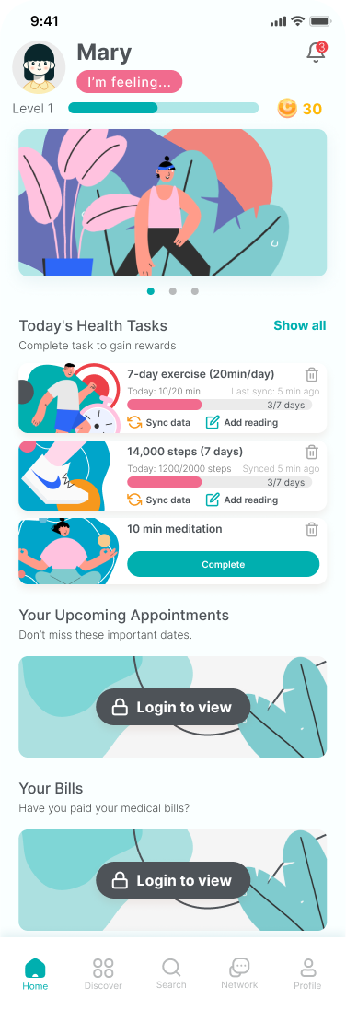
Home page
Home Page will be personalized based on:
initial information given by the user (Profile, Exp Customization Survey)
user data accumulated in the app (mood, goals, program data)
Top contents will be a fixed display
Avatar - tap to go to avatar page (to edit avatar)
Name - not editable. to edit go to Profile menu
Mood - display ‘Add Mood’ if no mood yet, display “I’m feeling ..” to display current mood
Notification bell - tap to display the Notification page
app Level - display the user’s current level and progress
app Points - to display the user’s Zest Points (ZP)
Middle widgets
Dynamic Carousel - to display events, campaigns, screening reminders
Today’s Health Tasks - to display today’s tasks based on goals set
Your Bills - to display outstanding bills
Your Upcoming Appointment - to display upcoming confirmed appointments
Bottom Menu
Home, Discover, Search, Network, Account
Notes:
[For discussion with Client]
What can a No login user see in Home Page? Do we want a No login user to click some features that require login and then ask them to do a singpass login? or do not give any access to those features at all.
to confirm the list of sections
what is my level,what is my score? make it more engaging
To add Exp/Coins icon, below notif bell. Upon click, go to rewards page.
+Add mood to change to own avatar, upon click, go to add mood page.
Remove date.
Should we show the mood of user in home page?
Exp
add mood, give 10 Exp, 5 exp points
discuss the rewards setup . Exp, coins
Wah! wah points, wah tasks… user level, single or multi points system (build the guidelines)

Slide 12
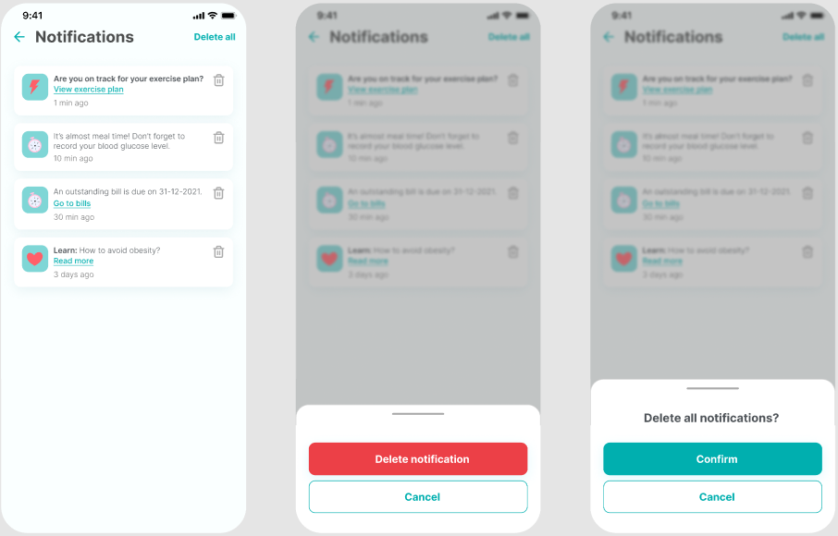

Notification
Clicking the bell will bring user to Notification page
Red dot in the notification bell means there are unread notifications
There will be different kinds of notifications
Transactions and goals reminders
Rewards notifications
Messages notifications
Ecoach nudges
Events / Programme invitations
Upon opening of the page, all notifications loaded on the page will be marked as read. Upon loading other notifications, notifications will be automatically marked as read.
To delete all displayed notifications, user can click Delete All.
To delete individual notifications, user can click the 3 dots and click delete.
Notes:
easy way to
10 notification - mark all
delete - left slide
read notifications after 48 hours can be archived
notification num - on the app icon

